Slide 1
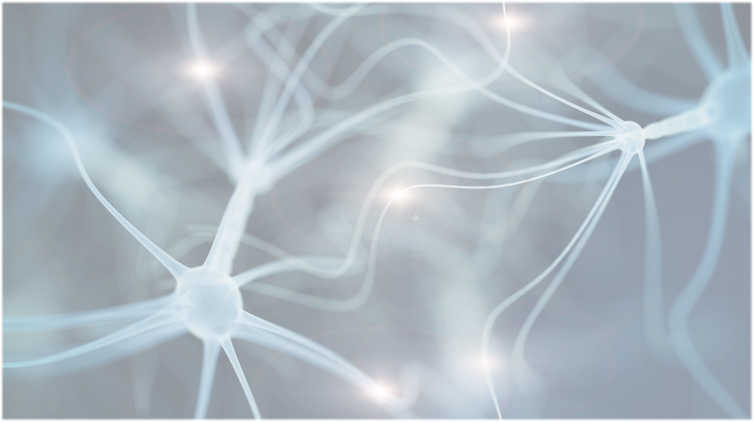

Hereditary Spastic Paraplegia
KIF5A
Alex Myers

Slide 2
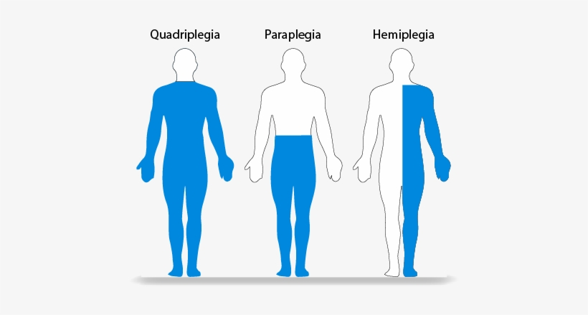
What is Paraplegia?

Slide 3
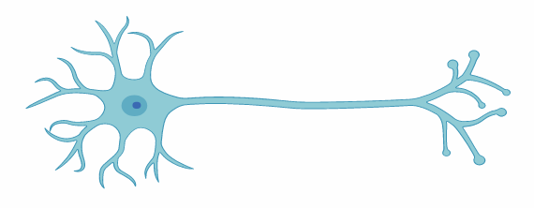

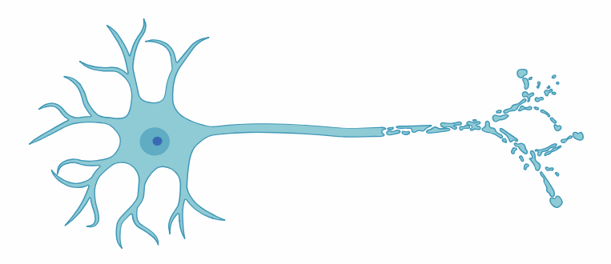
Hereditary Spastic Paraplegia (HSP)
Mutation
KIF5A
HSP

Slide 4
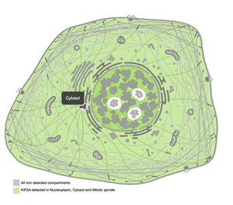
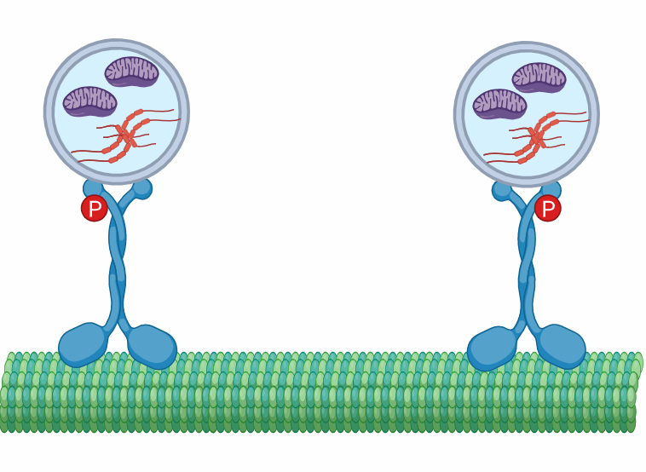
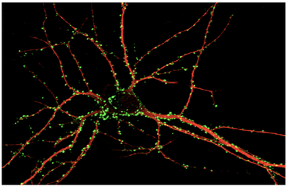
The role of KIF5A in Spastic Paraplegia 10
7
KISc
333
Cellular Component
Biological Process
Molecular Function
Axonal Organelle Transport
ATP-Dependent Microtubule Motor Activity
Kinesin Complex;
Neuronal Cell Body

Slide 5
What does KIF5A help transport?

Slide 6
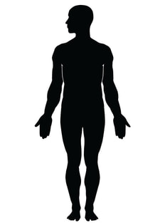





Conservation of KIF5A
Length (aa)
7
KISc
333
1033 aa
7
KISc
335
1033 aa
7
KISc
335
1027 aa
7
KISc
335
1027 aa
10
KISc
341
975 aa
9
KISc
337
815 aa

Slide 7
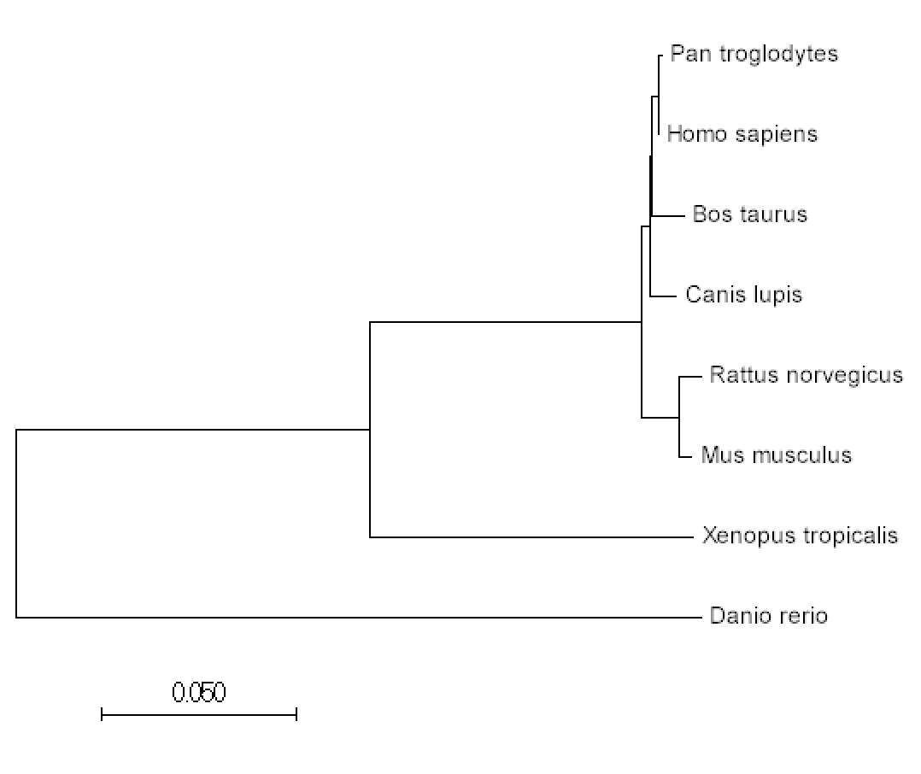





Relationship between the KIF5A homologs

Slide 8
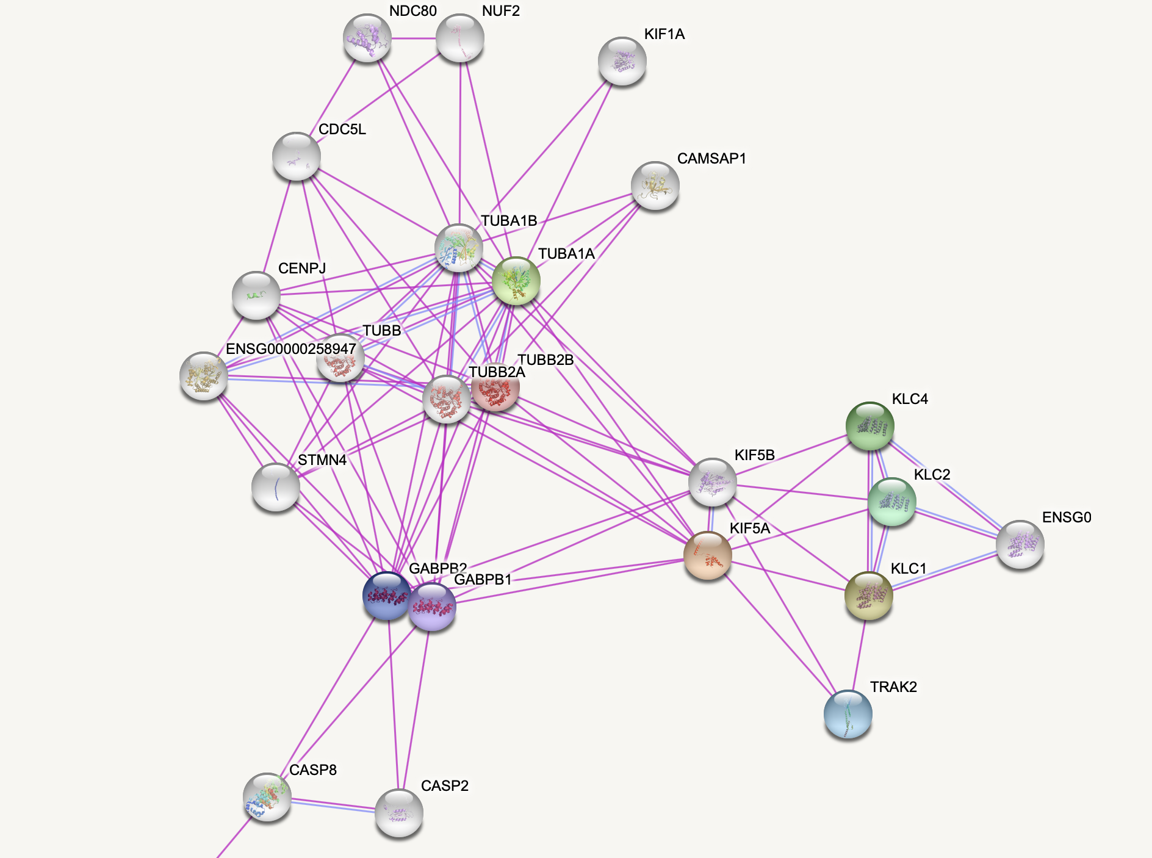
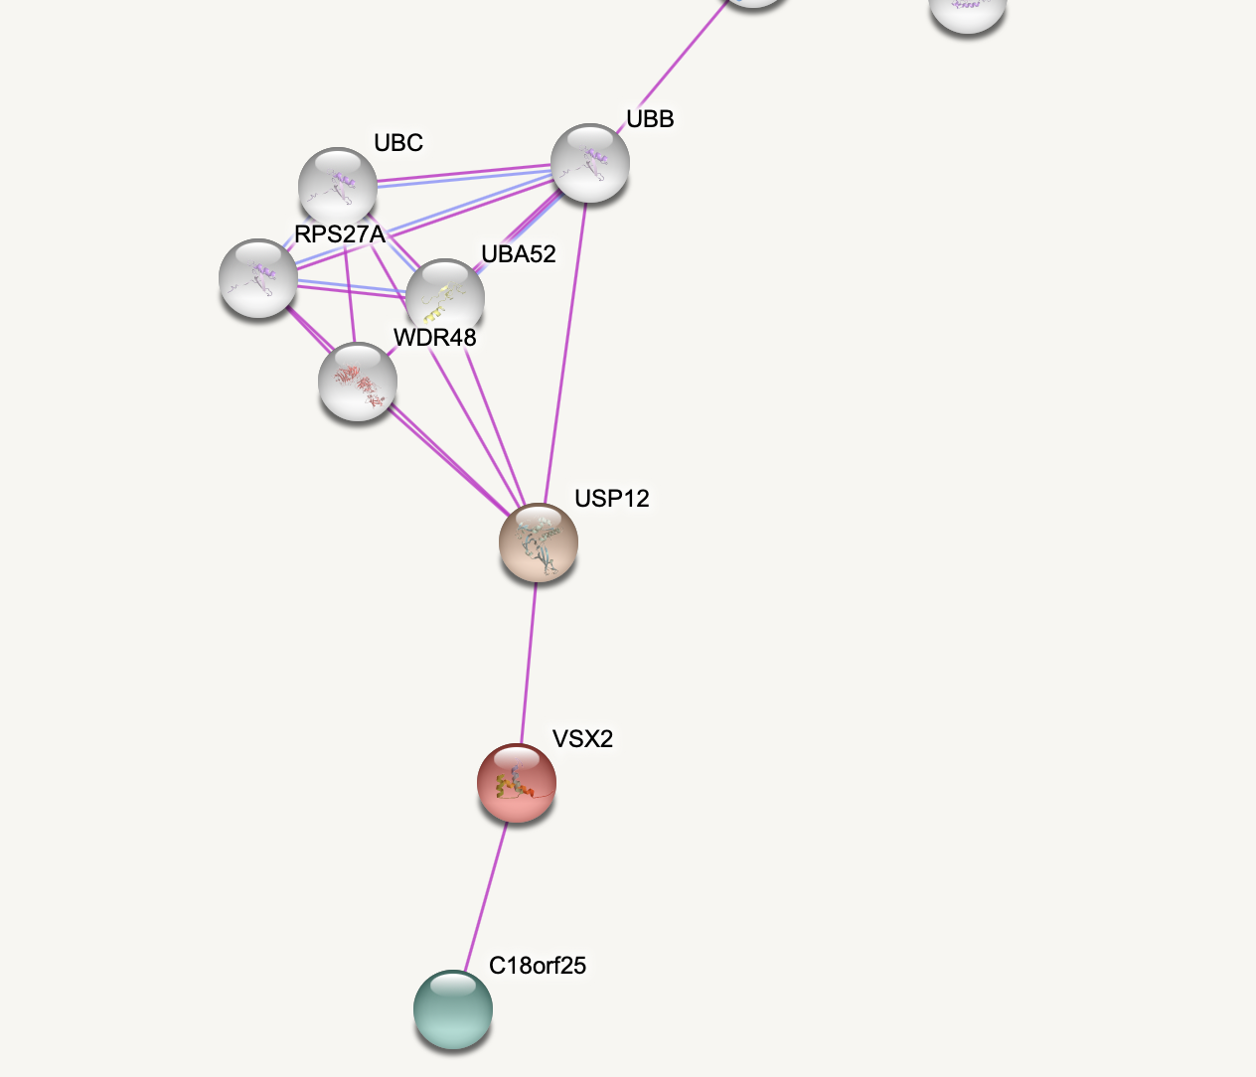
What Proteins interact with KIF5A?
Cell division and tubulin proteins
Kinesin proteins
Transcription factors
Body organization proteins

Slide 9
Hox 10 protein associates with KIF5A

Slide 10
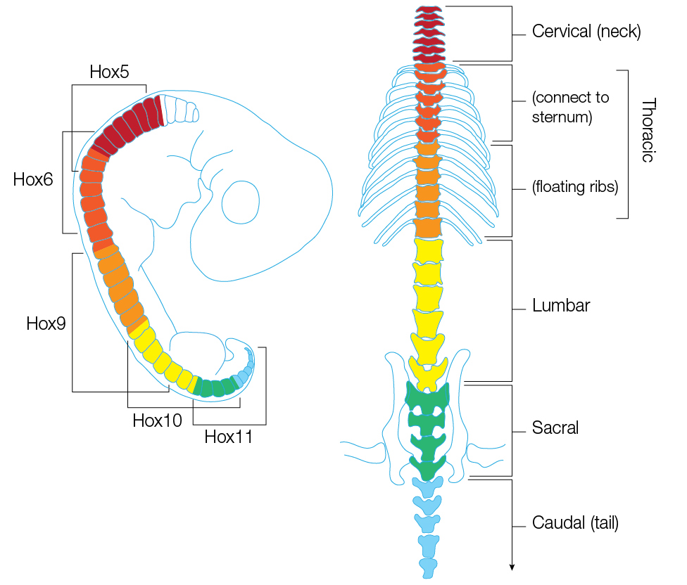
Hox 10 protein associates with KIF5A

Slide 11
Gap in Knowledge
Localization of KIF5A to the lower extremities such as the legs is still not fully understood

Slide 12
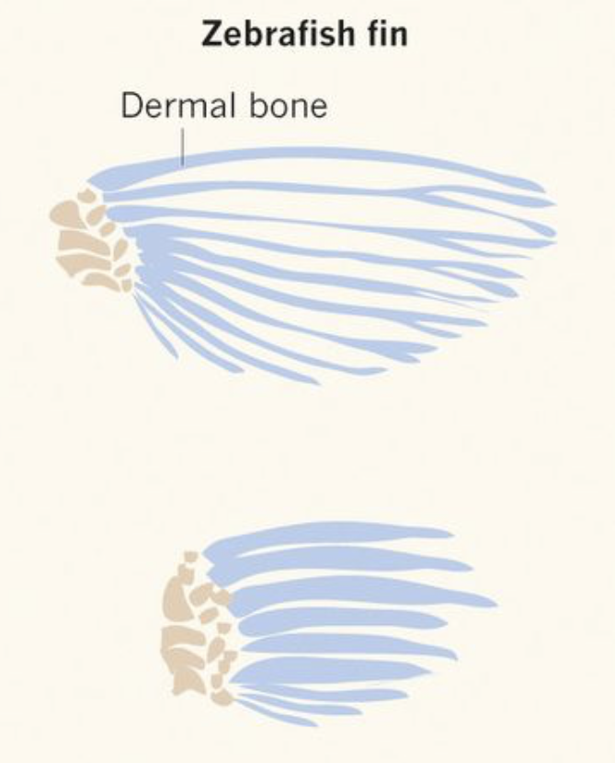
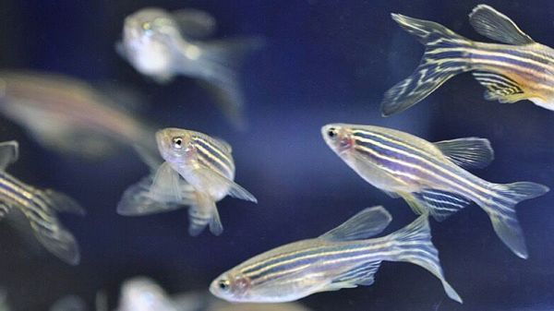
What Model Organism should be used?

Slide 13
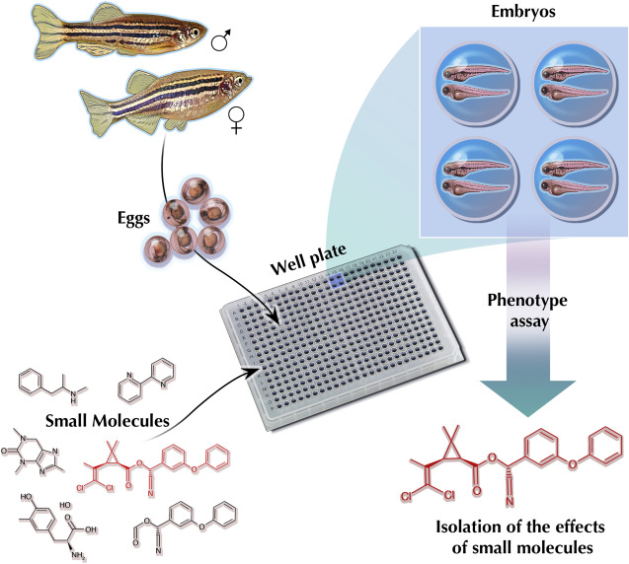
What is the primary goal?
To elucidate how KIF5A localizes to the lower extremities such as the legs
Aim 1
Aim 2
Aim 3
Identify novel proteins that interact with KIF5A targeting the protein to the legs
Characterize whether KIF5A localizes to the legs when Hox10 is knocked out
Identify chemicals that prevent localization of KIF5A by using a chemical screen

Slide 14
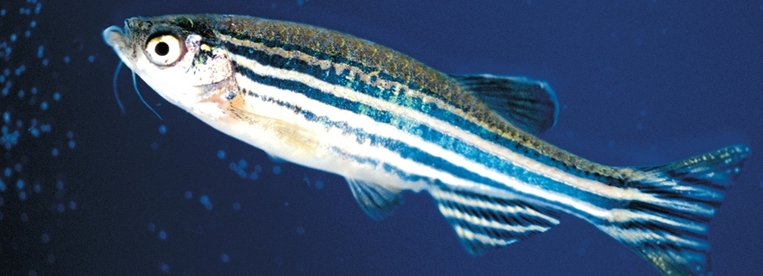
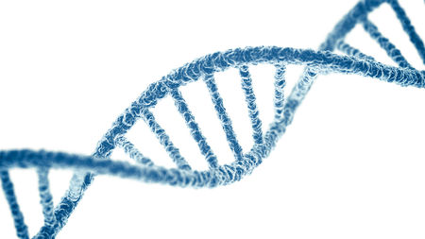
Aim 1: Characterize whether KIF5A localizes to the legs when Hox10 is knocked out
Hox 10
Crisper Cas9
Knockout the Hox10 gene
Observe localization of KIF5A
Expression levels of KIF5A
Screen for phenotype

Slide 15
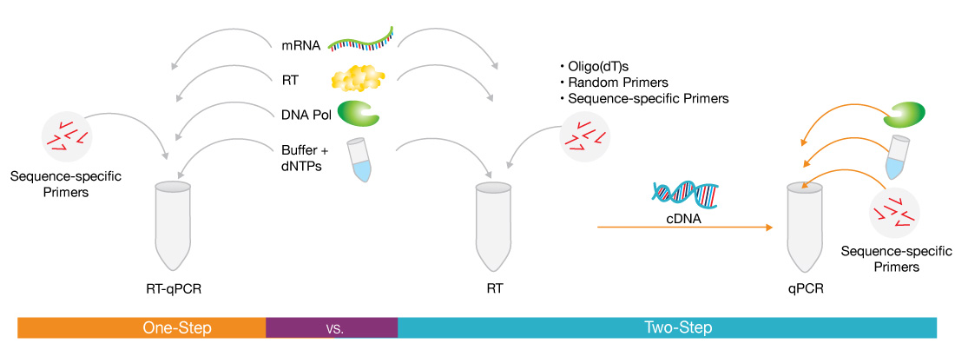
Aim 1: Characterize whether KIF5A localizes to the legs when Hox10 is knocked out using qPCR
Knockout the Hox10 gene
Expression levels of KIF5A
Observe localization of KIF5A
Screen for phenotype

Slide 16
Aim 1: Characterize whether KIF5A localizes to the legs when Hox10 is knocked out
Mutant
Wild Type
Knockout the Hox10 gene
Expression levels of KIF5A
Observe localization of KIF5A
Screen for phenotype

Slide 17
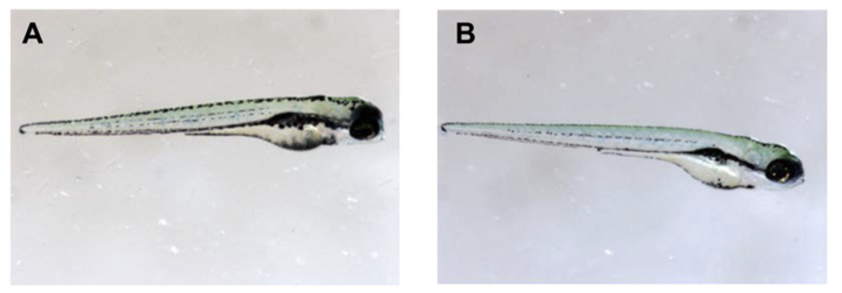
Aim 1: Characterize whether KIF5A localizes to the legs when Hox10 is knocked out
Mutant
Hypothesis: Knocking out Hox10 gene prevents localization of KIF5A in the extremities resulting in spasticity
Wild Type
Knockout the Hox10 gene
Observe localization of KIF5A
Expression levels of KIF5A
Screen for phenotype

Slide 18
Aim 2: Identify chemicals that prevent localization of KIF5A by using a chemical screen
Hox10
Mutant
Wild Type
Knockout the Hox10 gene
Obtain a Diverse Chemical Library
Screen for phenotype
Identify chemical

Slide 19
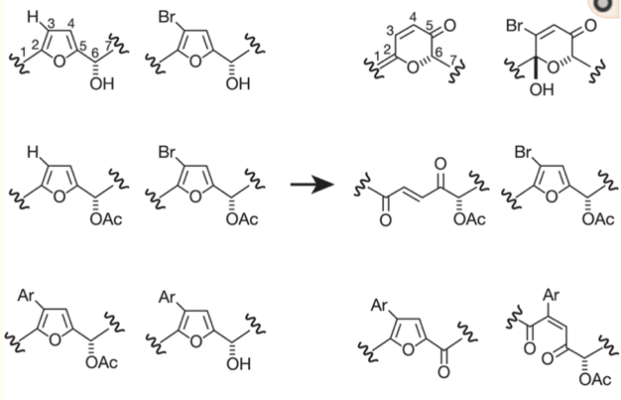
Aim 2: Identify chemicals that prevent localization of KIF5A by using a chemical screen
Knockout the Hox10 gene
Obtain a Diverse Chemical Library
Screen for phenotype
Identify chemical

Slide 20
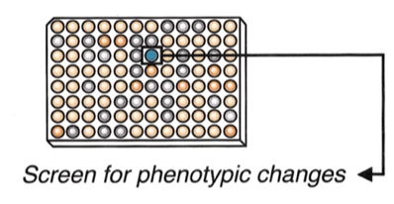
Aim 2: Identify chemicals that prevent localization of KIF5A by using a chemical screen
Recovered
Mutant (Spasticity)
No change
Wild Type
Knockout the Hox10 gene
Obtain a Diverse Chemical Library
Screen for phenotype
Identify chemical

Slide 21
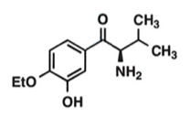
Aim 2: Identify chemicals that prevent localization of KIF5A by using a chemical screen
Recovered (no spasticity)
Hypothesis: By conducting a chemical screen we will be able to identify a chemical that can recover the Hox10 mutant
Knockout the Hox10 gene
Obtain a Diverse Chemical Library
Screen for phenotype
Identify chemical

Slide 22
Aim 3: Identify novel proteins that interact with KIF5A targeting the protein to the legs
Create mutants without limbs
Perform TAP Tag of KIF5A
Knockout gene of interest
Screen for fluorescence in limbs

Slide 23
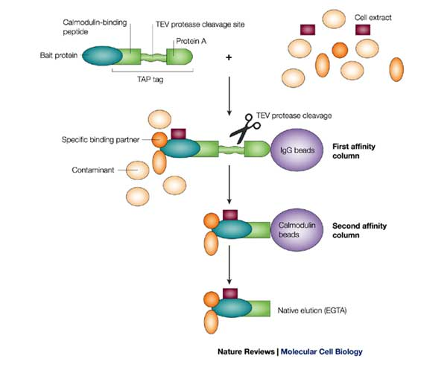
Aim 3: Identify novel proteins that interact with KIF5A targeting the protein to the legs
3
2
Bait
1
3
Bait
2
1
Create mutants without limbs
Perform TAP Tag of KIF5A
Knockout gene of interest
Screen for fluorescence in limbs

Slide 24
Aim 3: Identify novel proteins that interact with KIF5A targeting the protein to the legs
GFP
3
1
2
Bait
GFP
1
Create mutants without limbs
Perform TAP Tag of KIF5A
Knockout gene of interest
Screen for fluorescence in limbs

Slide 25
Aim 3: Identify novel proteins that interact with KIF5A targeting the protein to the legs
Wild Type
Mutant
Hypothesis: Given the results, TAP tags will likely be able to identify other novel proteins that target KIF5A to the lower extremities.
Create mutants without limbs
Perform TAP Tag of KIF5A
Knockout gene of interest
Screen for fluorescence in limbs

Slide 26
Future Directions

Slide 27
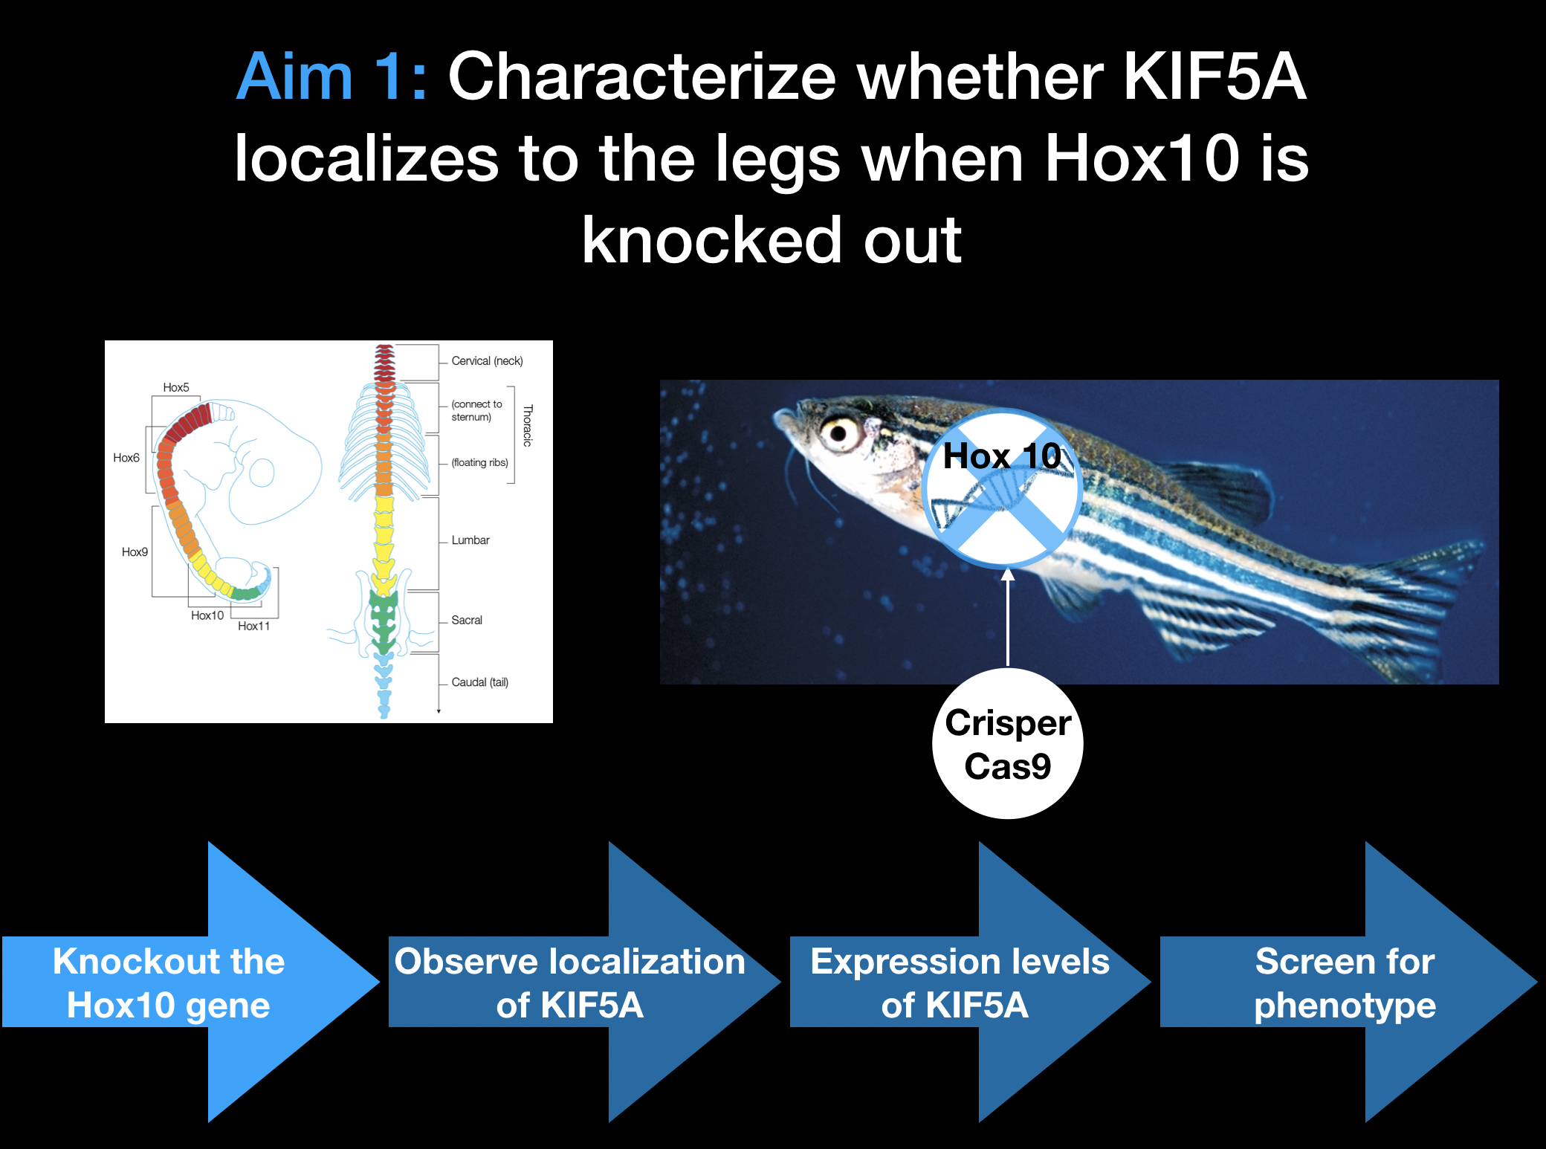
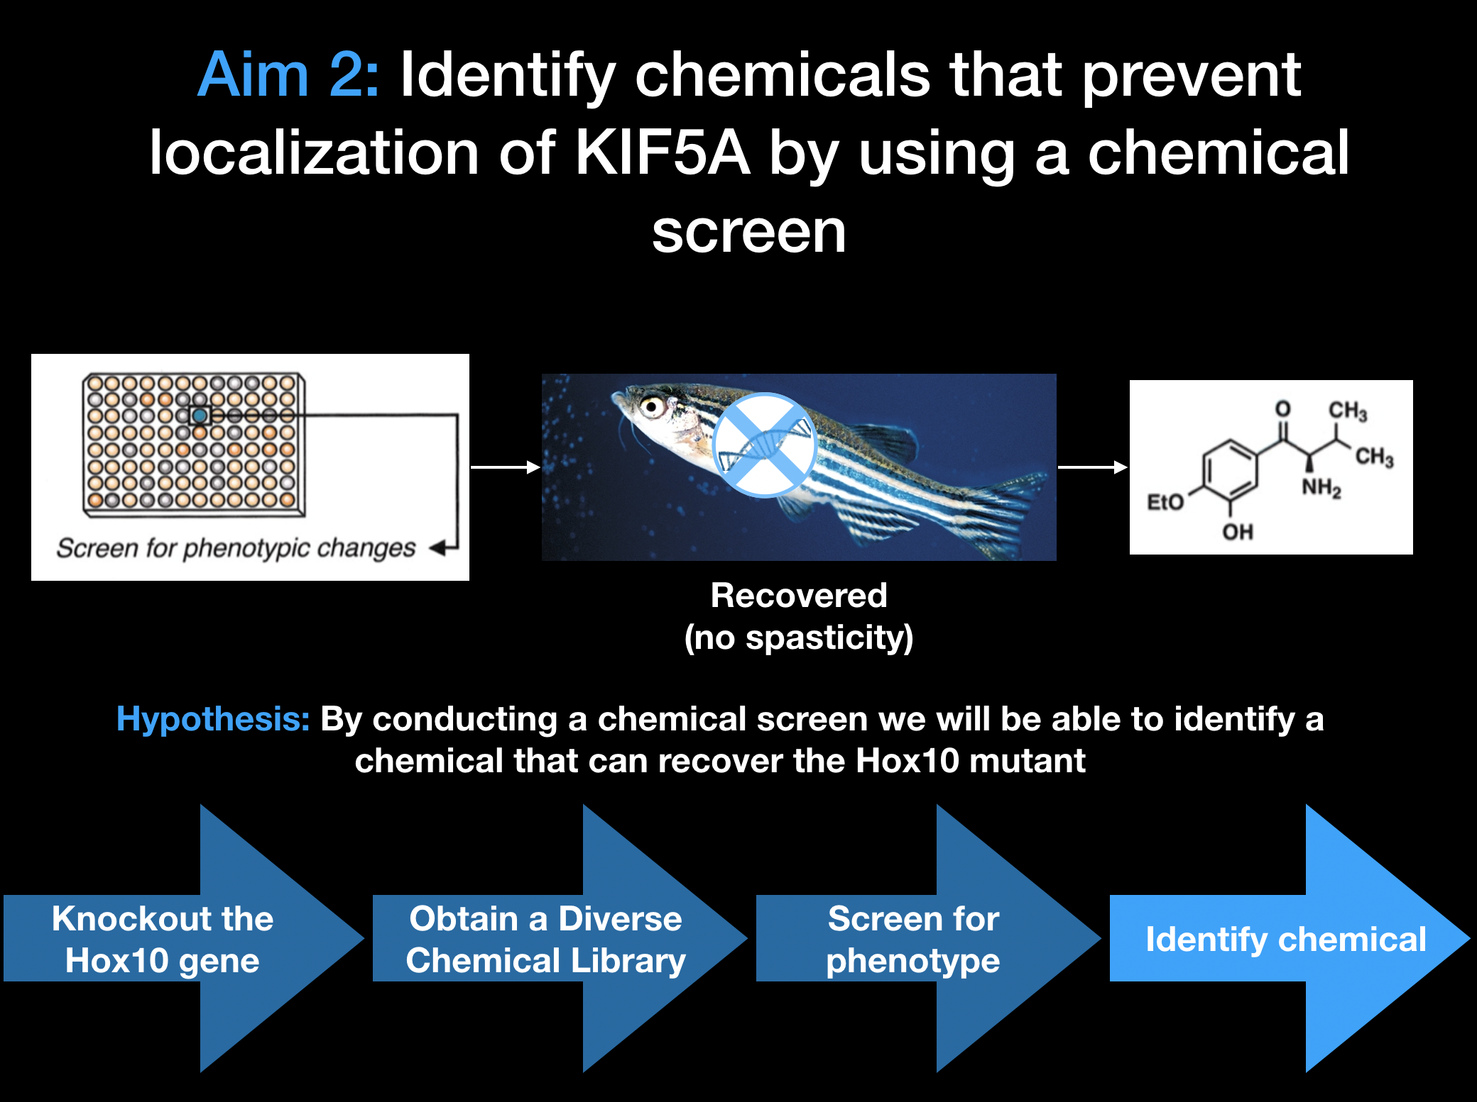
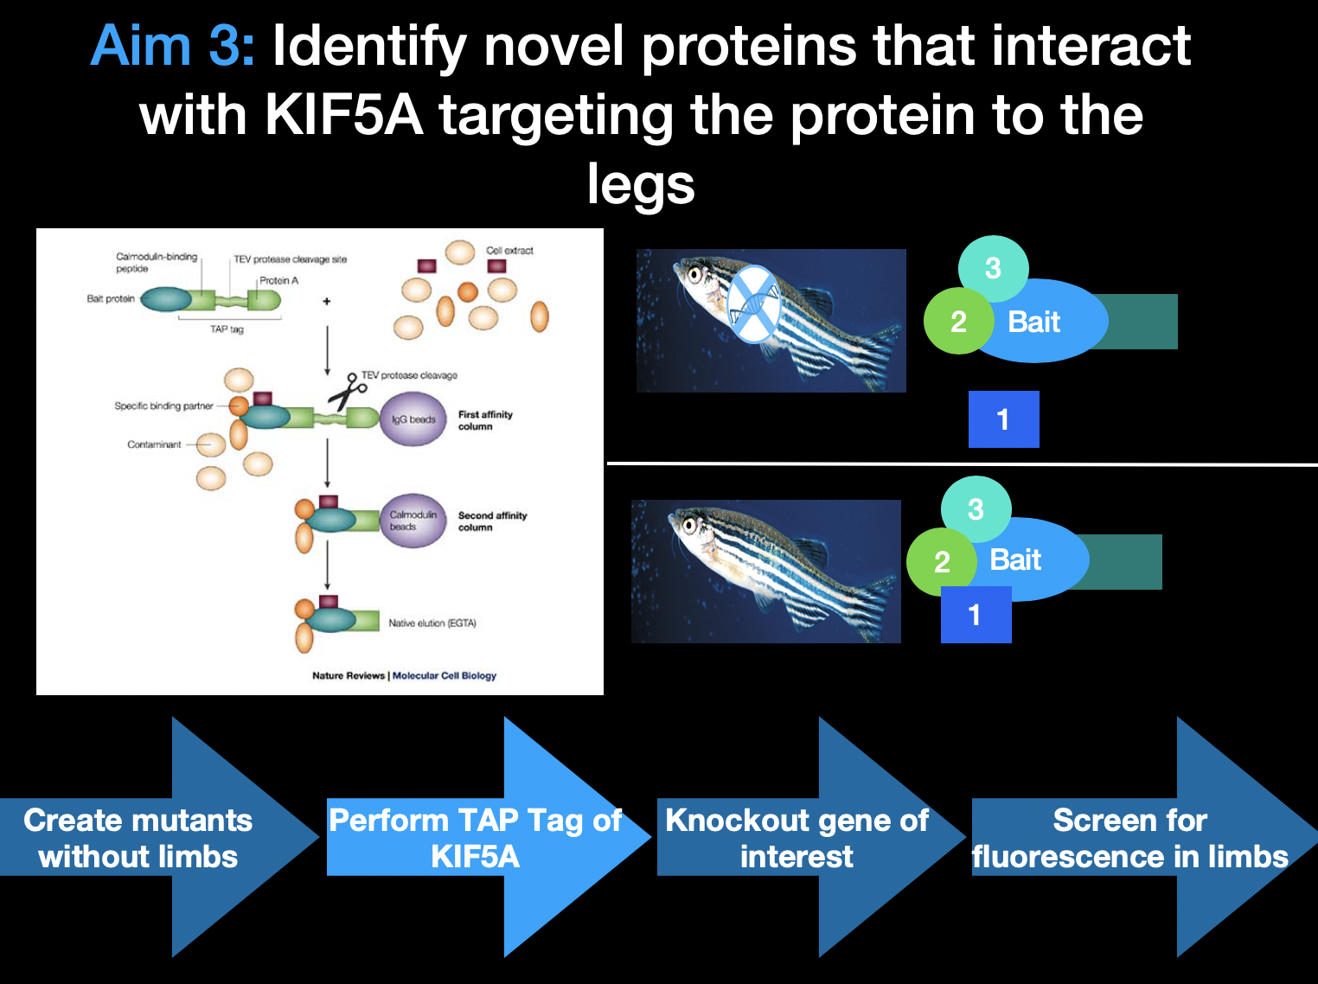
Summary
Knocking out Hox10 gene prevents localization of KIF5A in the extremities resulting in spasticity
By conducting a chemical screen we will be able to identify a small molecule that can recover the Hox10 mutant and aid with KIF5A localization
We will be able to identify other novel proteins that target KIF5A to the lower extremities like Hox10

Slide 28
References
[1] Hereditary Spastic Paraplegia (2016, April). Retrieved January 31, 2019, from https://rarediseases.info.nih.gov/diseases/6637/hereditary-spastic-paraplegia
[2] Spastic Paraplegia Foundation. Retrieved January 31, 2019, from https://sp-foundation-org.presencehost.net/who_we_are/overview.html
[3] Paik, N (2019, January). Hereditary Spastic Paraplegia. Retrieved January 31, 2019, from https://emedicine.medscape.com/article/306713-overview
[4] Reid, E (2002, November). A Kinesin Heavy Chain (KIF5A) Mutation in Hereditary Spastic Paraplegia (SPG10). Retrieved from https://www.ncbi.nlm.nih.gov/pmc/articles/PMC385095/
[5] Cuchanski, M., & Baldwin, K. J. (2018). Mutation in KIF5A c.610C>T Causing Hereditary Spastic Paraplegia with Axonal Sensorimotor Neuropathy. Case reports in neurology, 10(2), 165-168. doi:10.1159/000490456
[6] Musumeci, O., Bassi, M.T., Mazzeo, A. et al. Neurol Sci (2011) 32: 665. https://doi.org/10.1007/s10072-010-0445-8
[7] Filosto, M., Piccinelli, S. C., Palmieri, I., Necchini, N., Valente, M., Zanella, I., Biasiotto, G., Lorenzo, D. D., Cereda, C., … Padovani, A. (2018). A Novel Mutation in the Stalk Domain of KIF5A Causes a Slowly Progressive Atypical Motor Syndrome. Journal of clinical medicine, 8(1), 17. doi:10.3390/jcm8010017
[8] Kawaguchi, K. (2013). Role of Kinesin-1 in the Pathogenesis of SPG10, a Rare Form of Hereditary Spastic Paraplegia. The Neuroscientist, 19(4), 336–344. https://doi.org/10.1177/1073858412451655
Image References
https://spatax.wordpress.com/2015/05/30/clinical-and-genetic-heterogeneity-in-hereditary-spastic-paraplegias-from-spg1-to-spg72-and-still-counting-by-klebe-et-al-rev-neurol-2015/
https://www.pinterest.com/pin/435160382723050961/?lp=true
https://www.researchgate.net/publication/6784713_The_Genetics_of_Axonal_Transport_and_Axonal_Transport_Disorders/figures?lo=1
https://socratic.org/questions/how-is-a-neuron-adapted-to-perform-its-function
http://dev.nsta.org/evwebs/2553s/about/default.html
https://www.medifix.ie/common-conditions/hereditary-spastic-paraplegia/
https://phys.org/news/2017-06-mitochondria-blood-cell-formation.html
https://people.math.osu.edu/yang.2677/Files/Presentations/CandidacyPresentation_final.pdf
https://prostudies.uab.edu/search/publicCourseSearchDetails.do?method=load&courseId=4607518
https://www.cnbc.com/2017/08/25/what-drug-addled-zebrafish-can-tell-us-about-addiction.html
https://www.wired.com/2016/07/fish-creepy-curved-spines-help-explain-scoliosis/
https://learn.genetics.utah.edu/content/basics/hoxgenes/
https://bitesizebio.com/7206/introduction-to-dna-microarrays/
https://www.researchgate.net/publication/9053519_Chemical_Genetic_Approaches_to_Plant_Biology/figures?lo=1&utm_source=google&utm_medium=organic

